Slide 1
RNA-Seq Analysis of Regenerative Healing in Rangifer tarandus
Michael Sanfilippo

Slide 2
Background Recap…
Fibrotic Wound Healing
Why Reindeer?
In adult mammals, skin wounds typically heal through fibrotic repair
Fibroblasts deposit excessive extracellular matrix, leading to scar formation
Reindeer provide a unique model:
Antler velvet heals scarlessly (full regeneration)
Dorsal back skin heals via fibrosis (scar tissue)
Research Question
Dataset
How do temporal gene expression dynamics distinguish regenerative healing in antlers from fibrotic repair in dorsal skin?
We analyze a time-series bulk RNA-seq dataset (GSE168746) with 34 samples from 4 reindeer, collected across two tissues—antler velvet and dorsal skin—and spanning four healing stages: Days 0, 3, 7, and 14.

Slide 3
Computational Pipeline
01
02
03
04
05
06
Expression Analysis
Sequence Retrieval
InterProScan Annotation
DESeq2 and Visualizations
Retrieve protein sequences from Ensembl
Identify protein domains and associated GO terms
GO Annotation Mapping
Enrichment Visualization
Biological Category Assignment
Match GO terms from InterProScan results
Plot top enriched GO terms and top InterPro protein domains
Find terms associated with regeneration

Slide 4
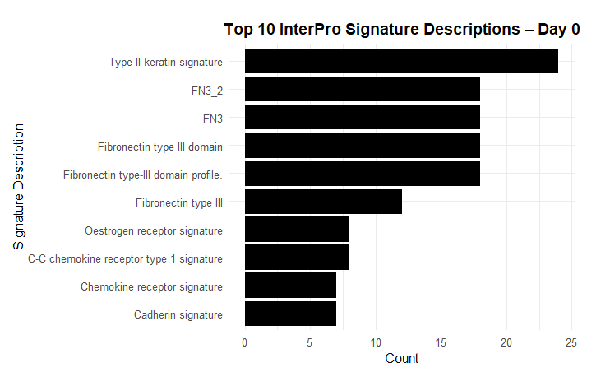
Antler Velvet Healing – Day 0
Day 0: Early Structural Repair Initiation
Focus: Rapid rebuilding of epithelial barriers and immune cell recruitment.
Key features: High expression of keratins, fibronectin, estrogen receptors, and chemokine signaling.
Biological priority: Physical wound closure, immune coordination, and preparing scaffolding for tissue regrowth.

Slide 5
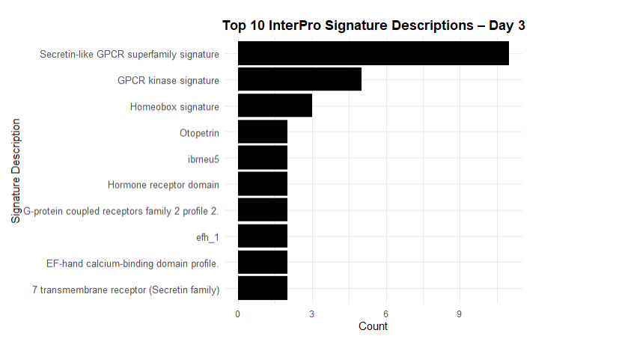
Antler Velvet Healing – Day 3
Day 3: Signal Detection and Patterning
Focus: Cell signaling and early tissue organization.
Key features: Activation of GPCR pathways, homeobox transcription factors for patterning, and calcium signaling.
Biological priority: Detecting wound signals, regulating immune response, and guiding cell fate decisions.

Slide 6
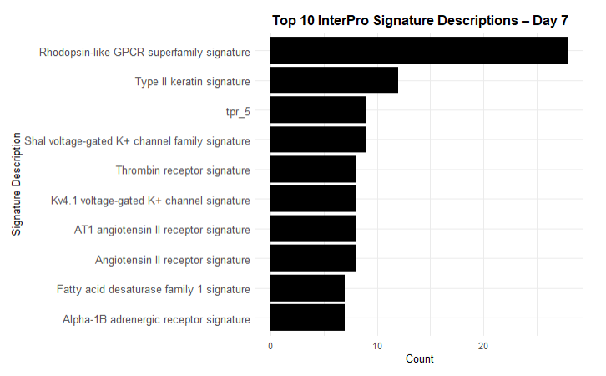
Antler Velvet Healing – Day 7
Day 7: Active Tissue Remodeling
Focus: Cell migration, tissue remodeling, and early functional recovery.
Key features: Continued keratin production, activation of potassium channels, angiogenesis, and inflammatory recruitment.
Biological priority: Organizing regenerating tissues, rebuilding blood vessels, and initiating nerve repair.

Slide 7
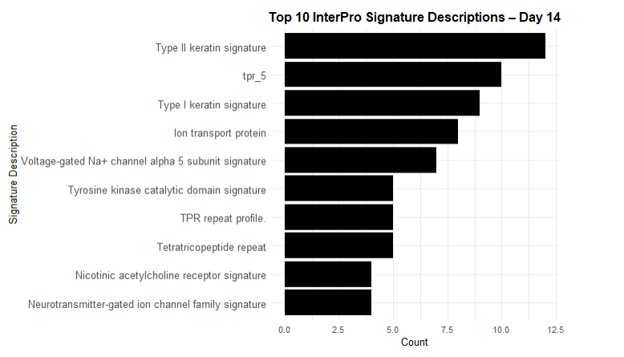
Antler Velvet Healing – Day 14
Day 14: Functional Maturation
Focus: Final tissue stabilization and reactivation of nerve and metabolic functions.
Key features: Strong keratin network, ion channel activity (sodium, potassium), growth factor signaling, and neuronal connectivity.
Biological priority: Completing tissue differentiation, restoring electrical activity, and achieving functional regeneration.

Slide 8
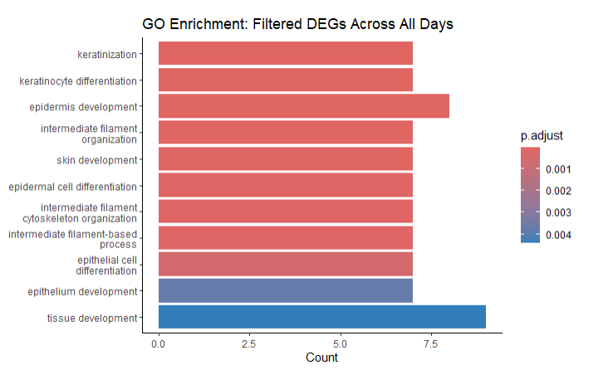
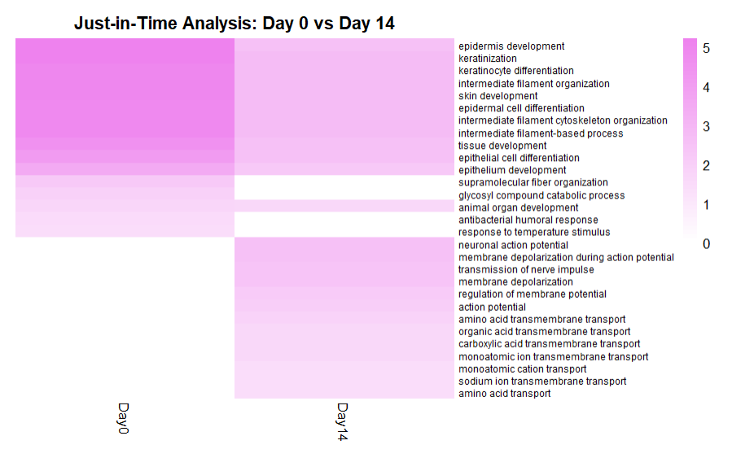
From Repair to Reconnection

Slide 9
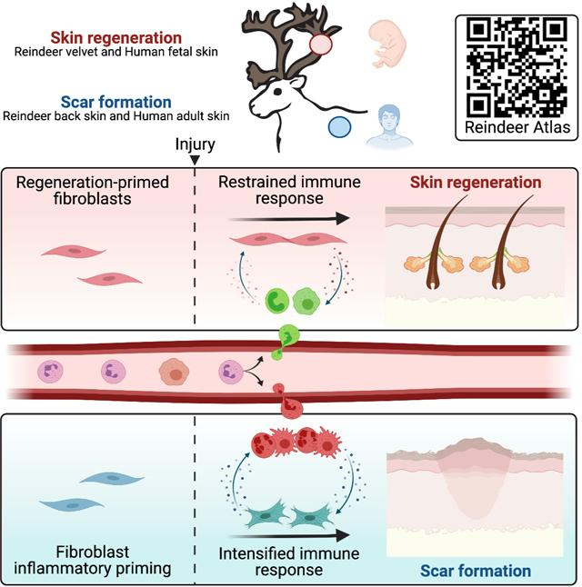
Fibrotic vs. Regenerative Healing
Key Features:
Rapid wound closure via collagen deposition by fibroblasts.
Excessive extracellular matrix (ECM) formation leads to scar tissue.
Chronic inflammation: Persistent immune signaling (e.g., TGF-β) prevents full tissue recovery.
Lack of regeneration: No restoration of functional tissue, nerve reconnection, or organ reactivation.
Outcome:
Efficient but results in non-functional, stiff tissue that lacks the original structure and function.

Slide 10

QUESTIONS?

